Slide 1
DPA Lab #2: Resyncronization
Module 3.2 from ChipWhisperer.io
Trainer: Colin O’Flynn

Slide 2
Preprocessing Module in Software
Traces
Attack Module
Preprocessing Modules

Slide 3
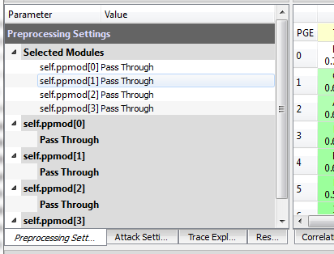
Preprocessing modules can be used for Low Pass Filtering, Resynchronizing, etc.
Very useful in practical situations with real devices!

Slide 4
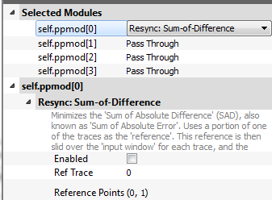
Playing with Preprocessing Modules

Slide 5
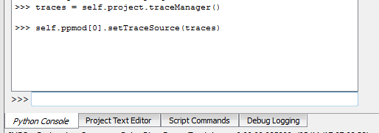
Setting Trace Source
traces = self.project.traceManager()
self.ppmod[0].setTraceSource(traces)

Slide 6
Example - Adding Jitter
Let’s make a (simple) countermeasure & then break it.
In file chipwhisperer/hardware/victims/firmware/simpleserial-aes/simpleserial-aes.c find this:
uint8_t get_pt(uint8_t* pt)
{
trigger_high();
aes_indep_enc(pt); /* encrypting the data block */
trigger_low();
simpleserial_put('r', 16, pt);
return 0x00;
}

Slide 7
Example – Adding Jitter
Append some “random” delay:
uint8_t get_pt(uint8_t* pt)
{
trigger_high();
for(volatile uint8_t k = 0; k < (*pt & 0x0F); k++);
aes_indep_enc(pt); /* encrypting the data block */
trigger_low();
simpleserial_put('r', 16, pt);
return 0x00;
}
This deterministic delay is NOT a good countermeasure, but is much easier to write in a single line since we don’t have a CSPRNG linked in. We’ll break the jitter without relying on the deterministic aspect though, so our attack would work against a better jitter source.

Slide 8
Build, Program, Test
make PLATFORM=CW303

Slide 9
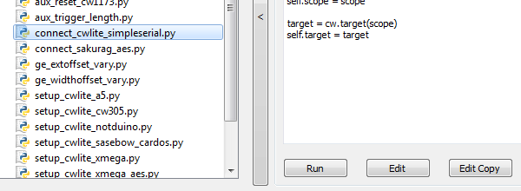
Run Setup Scripts

Slide 10
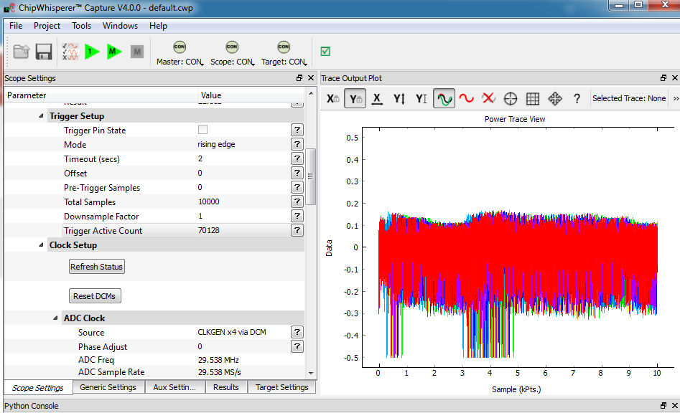
Using Capture 1 as Test

Slide 11
Capture Jittery Traces
Capture about 50 to 100 traces
Be sure to adjust OFFSET to ‘0’, and TOTAL SAMPLES to ‘10000’ (to account for jitter)
Either via GUI as in previous slide, or via command line:
>>> self.scope.adc.offset = 0
>>> self.scope.adc.samples = 10000

Slide 12
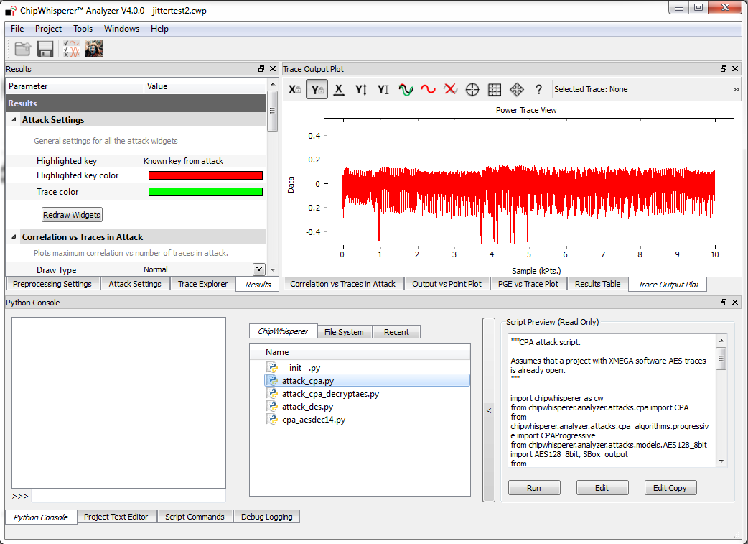
Testing “raw”CPA Attack

Slide 13
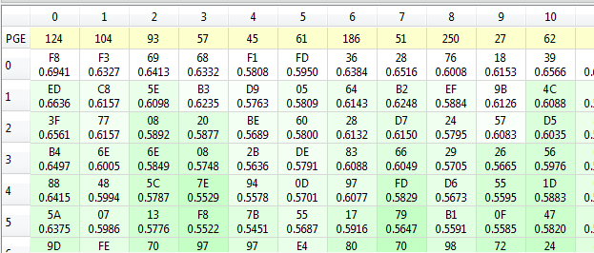
Notice very poor correlation

Slide 14
Testing Preprocessing:
Set Preprocessing Module ppmod[0] as Sum-of-Difference Realignment:

Slide 15
Testing Preprocessing:
On command line, set input source to module as our traces (this works if you ran that CPA attack example script):
>> self.ppmod[0].setTraceSource(traces)

Slide 16
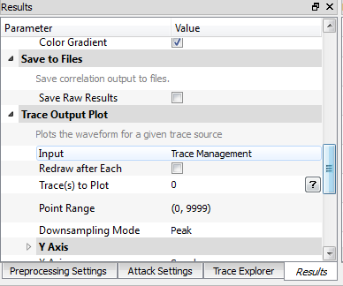
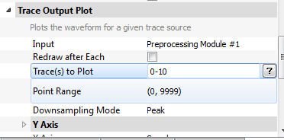
Testing Preprocessing:
On ‘Results’ tab, scroll down to ‘Trace Output Plot’
Plot traces 0-10
Set plot to come from Preprocessing Module #1

Slide 17
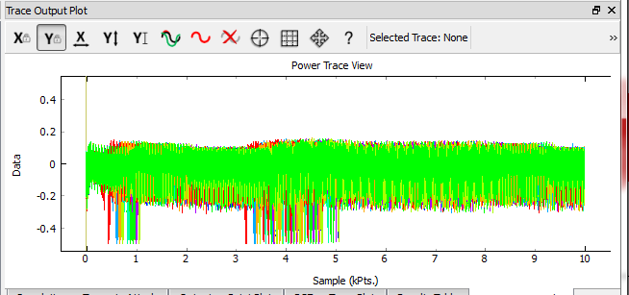
Summary of Settings for Test
Change ppmod[0] to Sum-of-Difference Realignment
self.ppmod[0].setTraceSource(traces)
On ‘Result’ tab change ‘Input’ to ‘Preprocessing Module #1’
Plot Traces 0-10
Hit ‘Redraw’

Slide 18
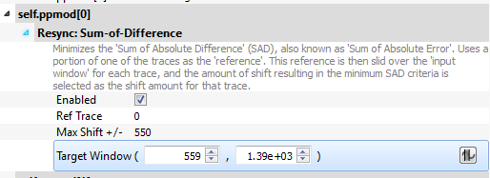
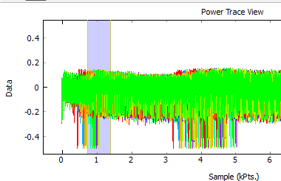
Input Window & Search Size

Slide 19
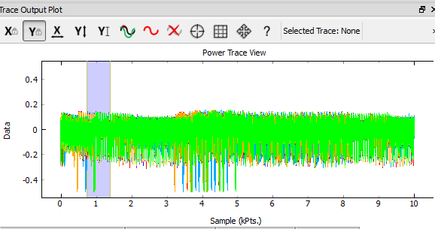
Finding Suitable Window?

Slide 20
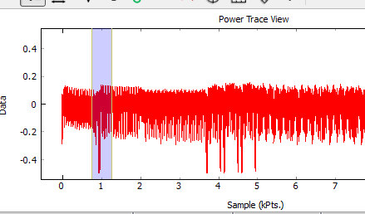
Window Hints
Too large an area might be bad
Try switching back to single trace (trace 0) to find a unique feature, and set reference points on that. Very important to select unique feature.

Slide 21
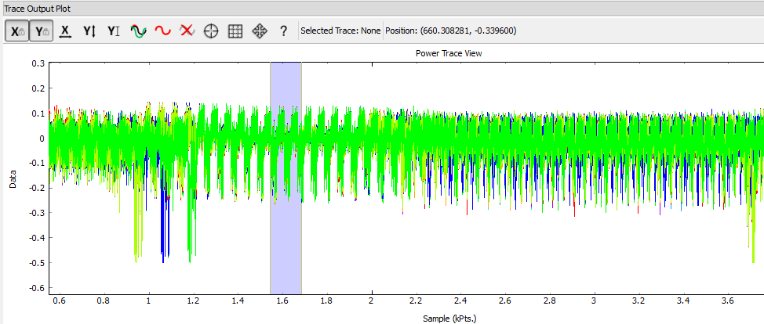
Possible Problems
Watch out for Max Shift not taking your window outside of trace start/end. You will get error when this happens.
Watch out for “false synchronization” where you catch part of the waveform:

Slide 22
To the Attack!
We have two options now, will show you both of them:
Use the GUI ppmod object we control in our attack script.
Make an attack script with the settings encoded (this is better long-term to prevent forgetting / accidently closing something!).

Slide 23
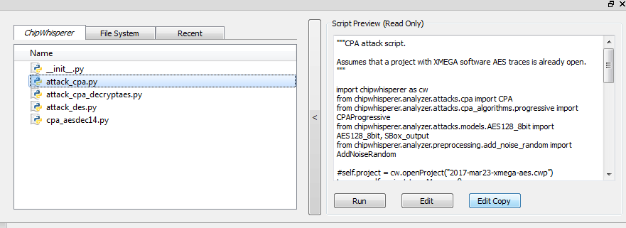
Example #1: Using Resync Traces
Make a new script using “Edit Copy” button of the CPA attack that failed.

Slide 24
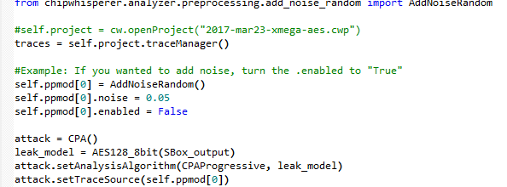
Example #1: Using Resync Traces
Make a new script using “Edit Copy” button of the CPA attack that failed.
Remove this! Otherwise will overwrite your object & you’ll be sad.
Currently we get traces from ppmod[0] anyway ☺

Slide 25
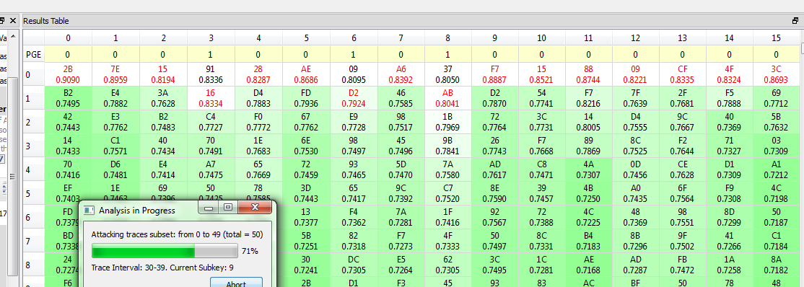
Example #1: Using Resync Traces

Slide 26
Example #2: Using Special Script
Make a new script using “Edit Copy” button of the CPA attack that failed.

Slide 27
Example #2: Using Special Script
From gui, access ‘self.ppmod[0]’ to see settings:
>>> self.ppmod[0]
enabled = True
ref_trace = 0
max_shift = 700
target_window = (700, 1500)

Slide 28
Example #2: Using Special Script
Modify script to include a “ResyncSAD” object, and point it to your traces with those settings:
from chipwhisperer.analyzer.preprocessing.resync_sad import ResyncSAD
traces = self.project.traceManager()
resync_traces = ResyncSAD(traces)
resync_traces.enabled = True
resync_traces.ref_trace = 0
resync_traces.max_shift = 700
resync_traces.target_window = (700, 1500)
attack = CPA()
leak_model = AES128_8bit(SBox_output)
attack.setAnalysisAlgorithm(CPAProgressive, leak_model)
attack.setTraceSource(resync_traces)
…REST OF FILE AS BEFORE…

Slide 29
Example #2: Using Special Script

Slide 30
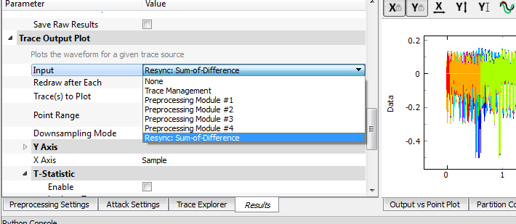
Checking Script Output
NB: This object exists/updated ONLY after hitting “RUN” button!

Slide 31
This training content is Copyright © NewAE Technology Inc. 2016-2017. ChipWhisperer is a trademark of NewAE Technology Inc., registered in the United States of America and Europe. See terms and conditions at ChipWhisperer.io

