Slide 1
Differential Power Analysis
Module 3.0 from ChipWhisperer.io
Trainer: Colin O’Flynn

Slide 2
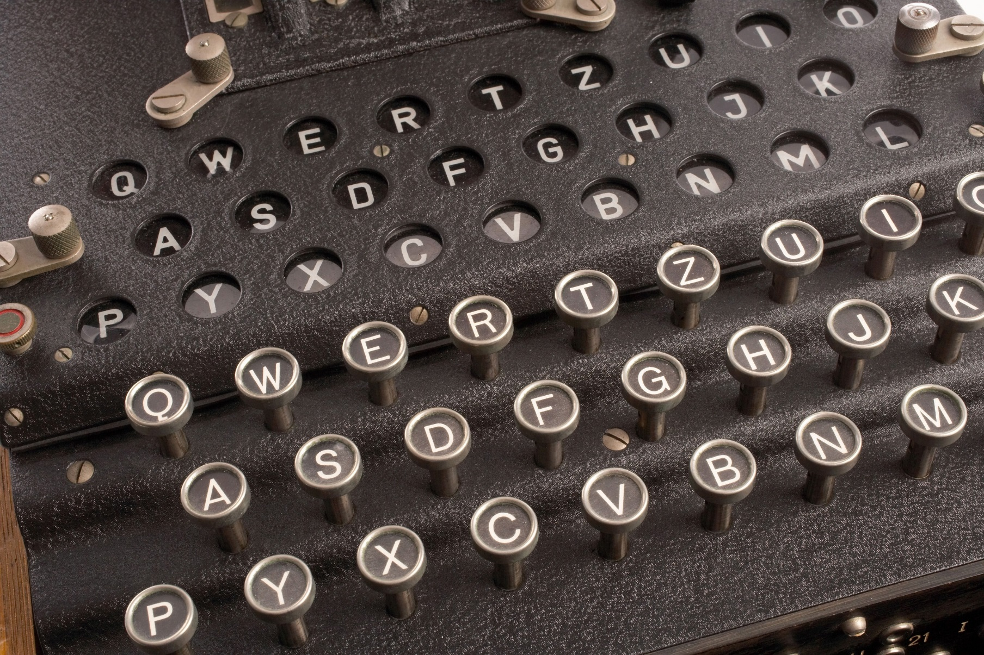
What does encryption do for us?

Slide 3
What does encryption do for us?

Slide 4
Encryption Parlance
Plaintext – The input to the algorithm
Ciphertext – The output of the algorithm
Secret Key – The “key” that maps plaintext to ciphertext

Slide 5
Encryption Types
Symmetric – Uses the same key for both sides of conversation
Asymmetric – Uses different keys for both sides of conversation

Slide 6
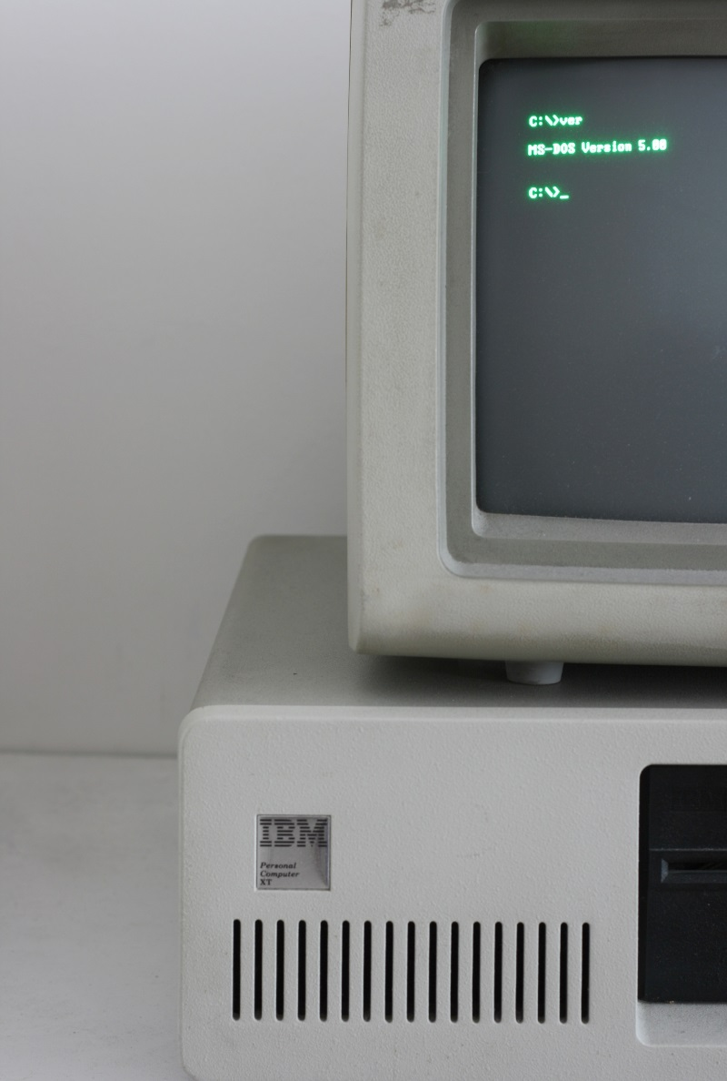
Where does encryption come from?

Slide 7
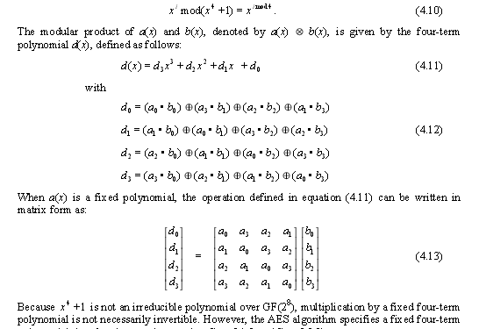
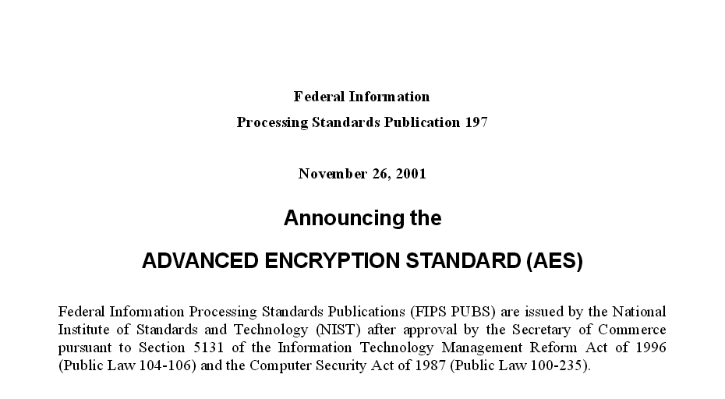
Designing encryption implementations.
http://csrc.nist.gov/publications/fips/fips197/fips-197.pdf

Slide 8
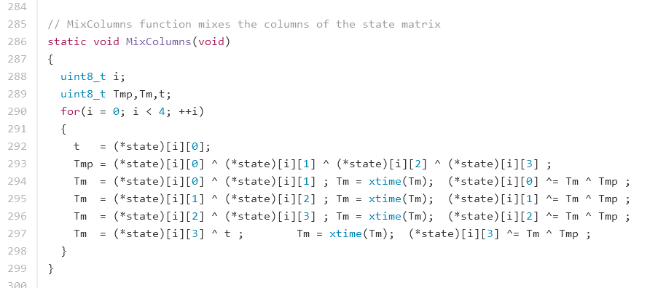
Designing encryption implementations.

Slide 9
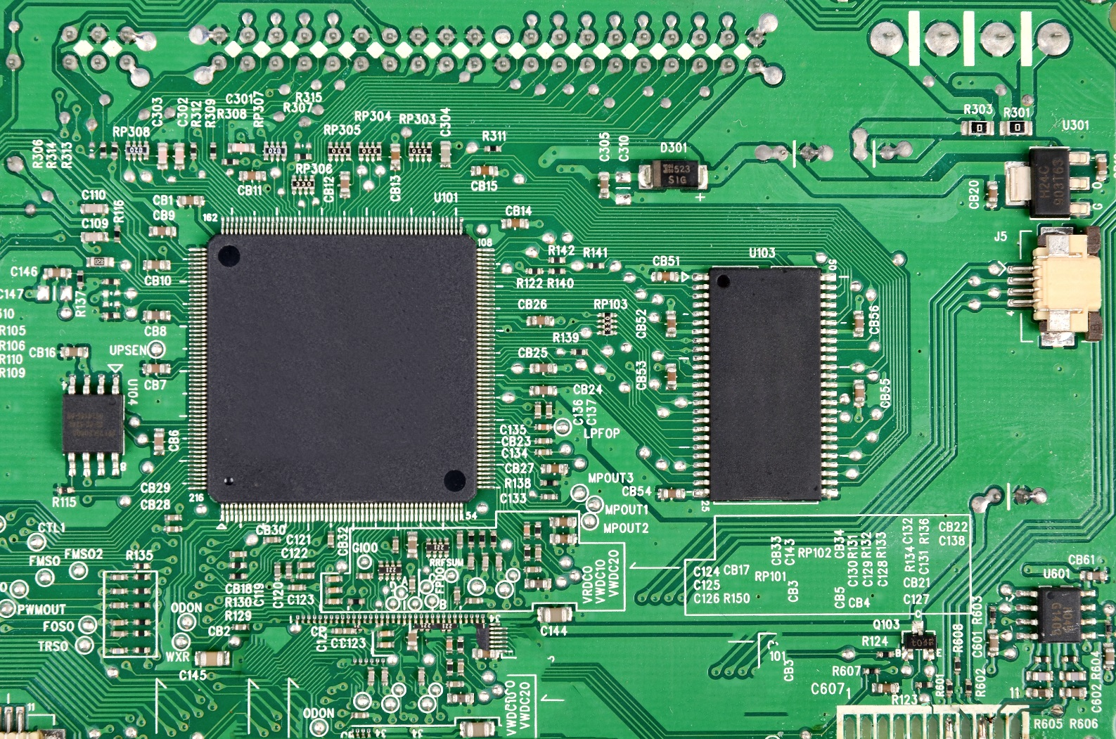
Encryption in hardware modules

Slide 10
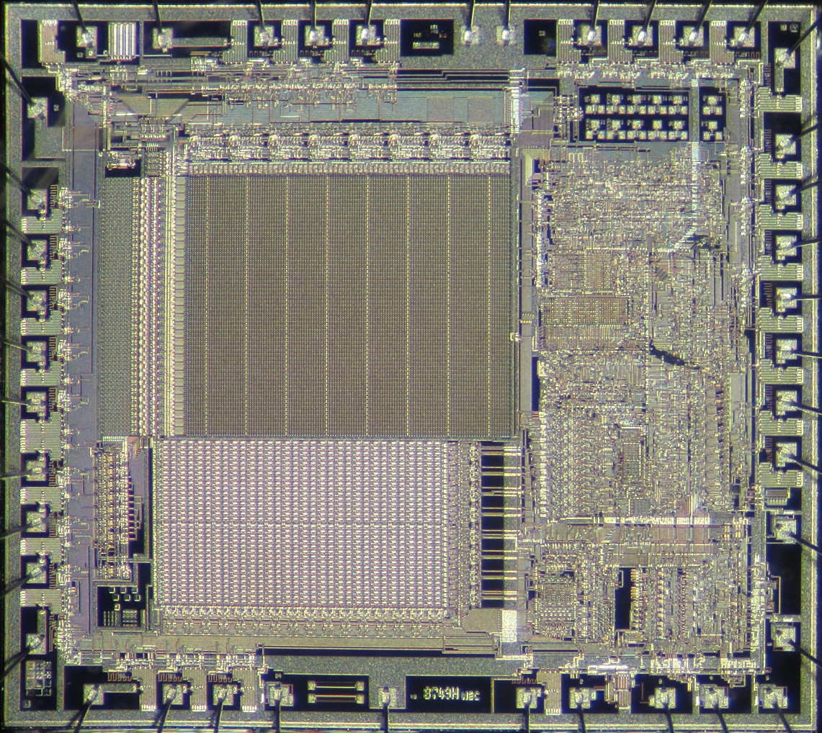
Looking inside an IC
Photo by Pauli Rautakorpi, CC-SA 2.0 License

Slide 11
Back to Basics

Slide 12
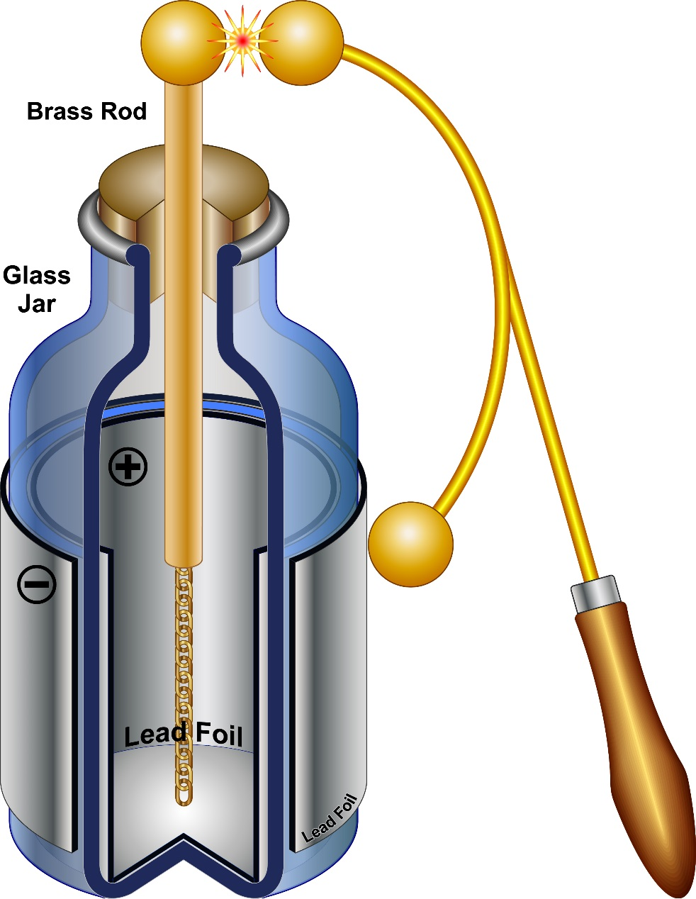
Back to Basics

Slide 13
Capacitors?

Slide 14
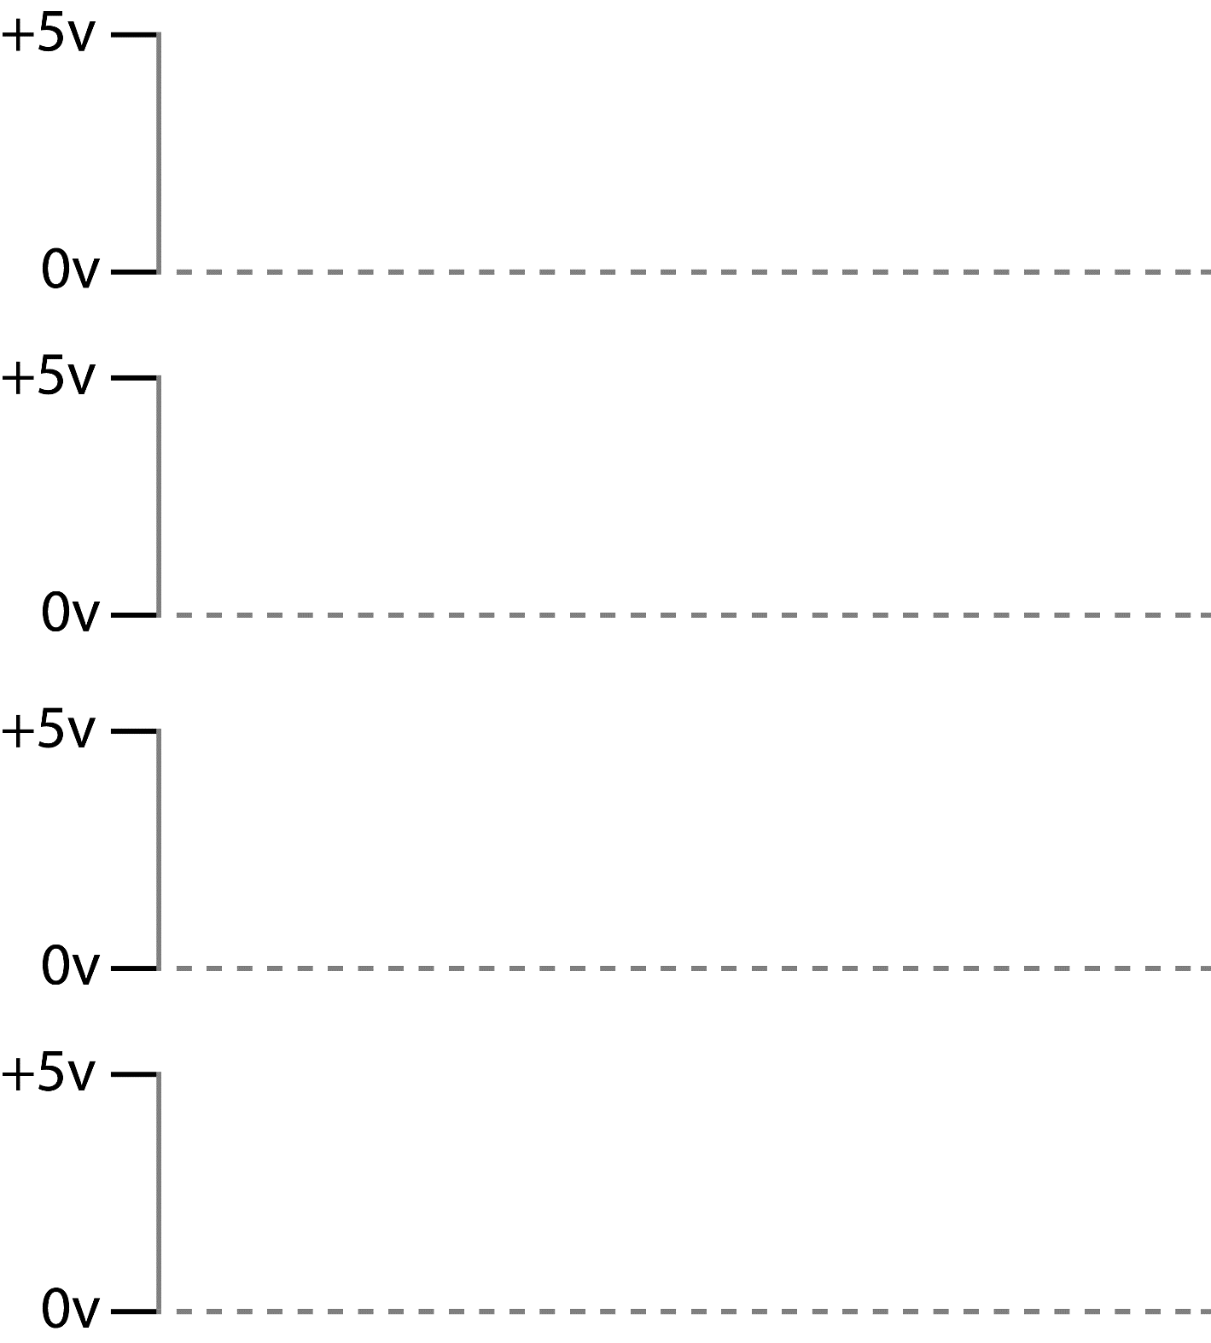
Data Busses...

Slide 15
Summary So Far
Power equivalent to number of bits changing on data bus

Slide 16
Pre-Charge

Slide 17
Summary So Far
Power equivalent to number of bits set to 1 on data bus.

Slide 18
How do we exploit this!?!

Slide 20
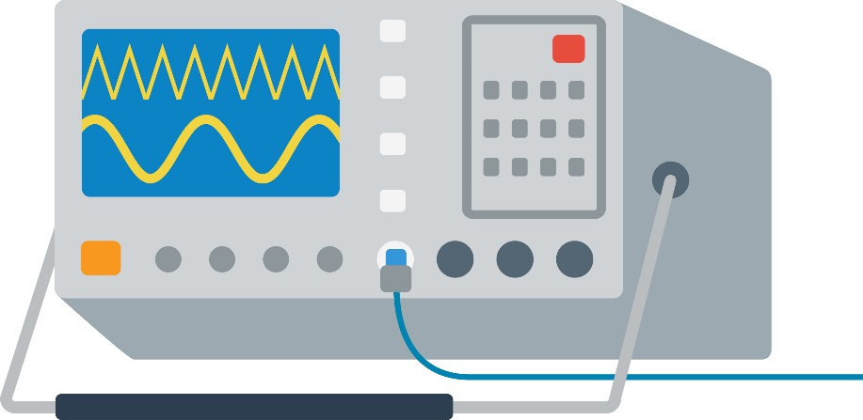
Running the attack

Slide 21
Attack Results
Input Data | Power Measurement

Slide 22
Attack Results
Input Data | Power Measurement
0xC7
0x1F
0x2C
0x89
0x01
0xD2

Slide 23
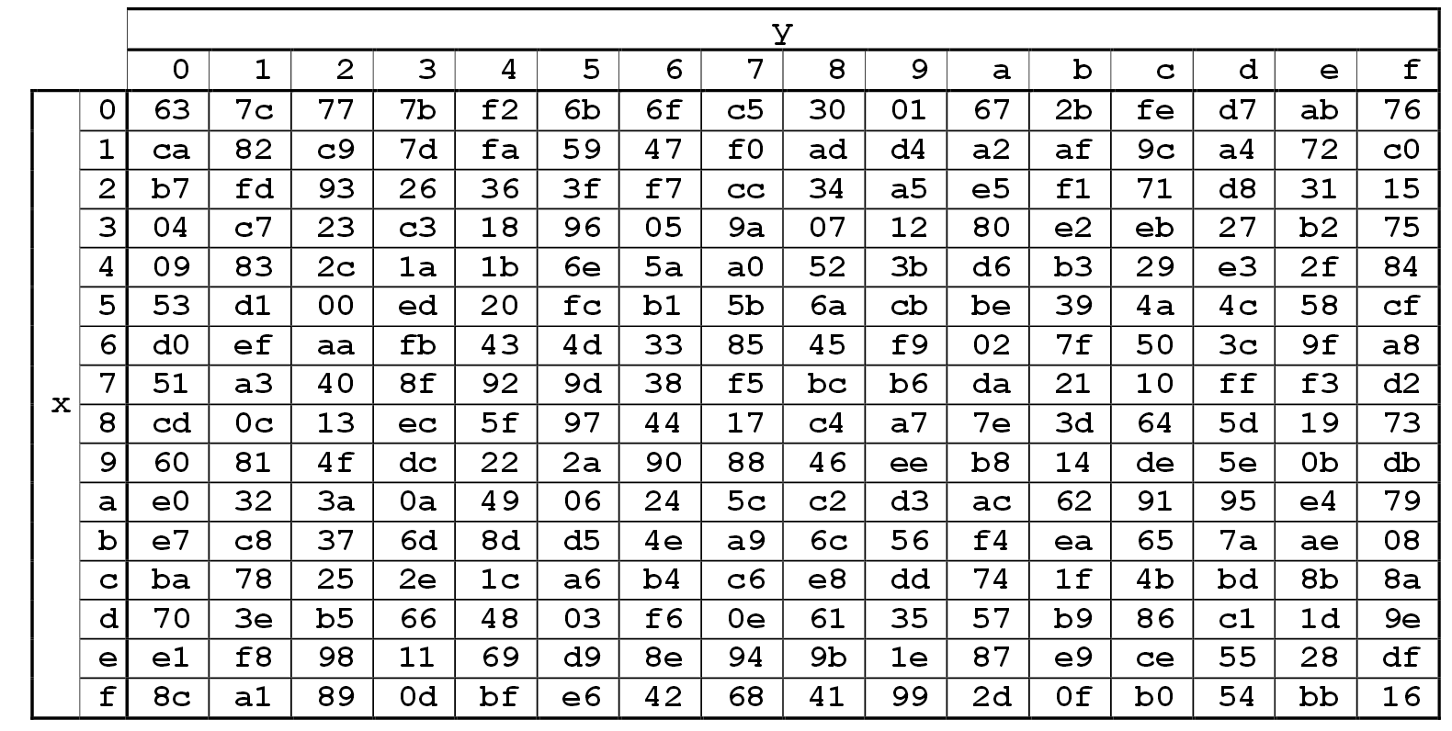
Model of Encryption Device
Lookup Table (AES Substitution Box or S-Box)

Slide 24
Attack Results
Input Data | Hyp. Key | XOR Output | Hyp. Output | Number 1’s
0xC7 | 0x00 | 0xC7 | 0xC6 | 4
0x1F | 0x00 | 0x1F | 0xC0 | 2
0x2C | 0x00 | 0x2C
0x89 | 0x00 | 0x89
0x01 | 0x00 | 0x01
0xD2 | 0x00

Slide 25
Attack Results
Input Data | Hyp. Key | XOR Output | Hyp. Output | Number 1’s
0xC7 | 0x01 | 0xC6 | 0xB4 | 4
0x1F | 0x01 | 0x1E | 0x72 | 5
0x2C | 0x01 | 0x2D | 0xD8 | 4
0x89 | 0x01 | 0x88
0x01 | 0x01 | 0x00
0xD2 | 0x01 | 0xD3

Slide 26
Attack Results
…bunch more tests…

Slide 27
Attack Results
Input Data | Hyp. Key | XOR Output | Hyp. Output | Number 1’s
0xC7 | 0x3D | 0xFA | 0x2D | 4
0x1F | 0x3D | 0x22 | 0x93 | 4
0x2C | 0x3D | 0x11 | 0x82 | 2
0x89 | 0x3D | 0xB4 | 0x8D | 4
0x01 | 0x3D | 0x3C | 0xEB | 6
0xD2 | 0x3D | 0xEF | 0xDF | 7

Slide 28
Attack Results
…bunch more tests…

Slide 29
Attack Results
Input Data | Hyp. Key | XOR Output | Hyp. Output | Number 1’s
0xC7 | 0xFF | 0x38 | 0x07 | 3
0x1F | 0xFF | 0xE0 | 0xE1 | 4
0x2C | 0xFF | 0xD3 | 0x71 | 4
0x89 | 0xFF | 0x76 | 0x38 | 3
0x01 | 0xFF | 0xFE | 0xBB | 6
0xD2 | 0xFF | 0x2D | 0xB5 | 5

Slide 30
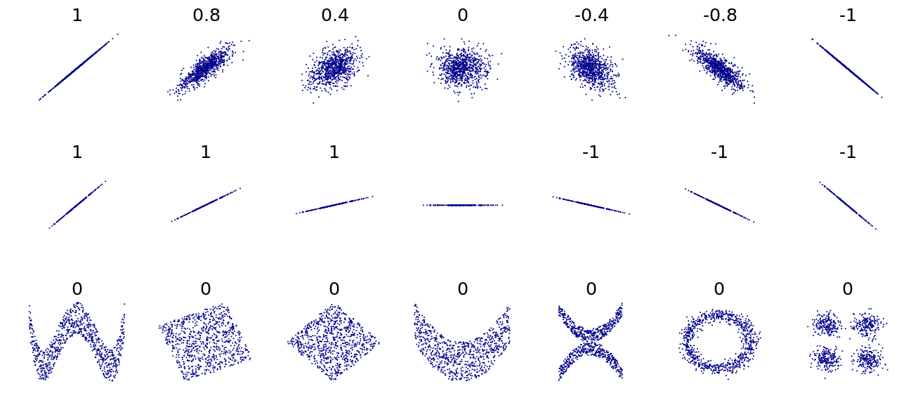
Correlation
Image credit: Denis Boigelot, released into public domain.

Slide 31
Correlation Power Analysis
.. | 0x3D | .. | 0xFF
 | 4 |  | 3
 | 4 |  | 4
 | 2 |  | 4
 | 4 |  | 3
 | 6 |  | 6
 | 7 |  | 5

Slide 32
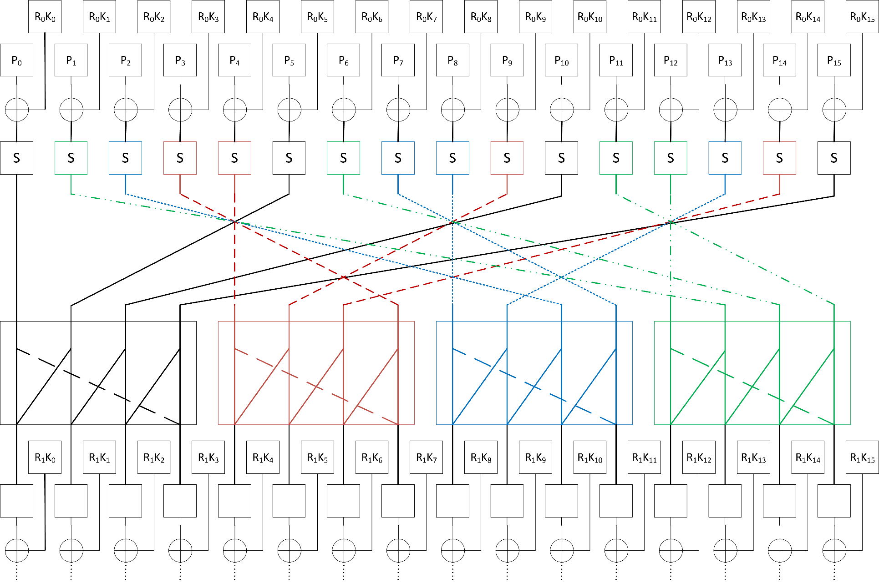
Applying to AES

Slide 33
AES Key-Space Size
2¹²⁸ = 3.4028x10³⁸
…if you could try 10 000 000 000 keys/second

Slide 34
AES Key-Space Size
2¹²⁸ = 3.4028x10³⁸
…if you could try 10 000 000 000 keys/second
3.4028x10²⁸ seconds
9.45x10²⁴ hours
1.08x10²¹ years
… that’s 1 078 289 752 TRILLION years…

Slide 35
Applying to AES

Slide 36
Side-Channel search space
2⁸ = 256
256 x 16 = 4096

Slide 37
Where can this be applied?
Device performs encryption operation with (unknown) secret key.
Ideally allows us to request these encryptions with known or controlled data.

Slide 38
Summary – To Be Confirmed in Labs
Digital devices fundamentally leak information related to the data being manipulated (not just instructions).
This leakage can be used as an attack to determine secret data.
This attack (as in SPA) relies on the device to be actively manipulating the secret data.
Doesn’t require a lot of equipment to get started!

Slide 39
This training content is Copyright © NewAE Technology Inc. 2016-2017. ChipWhisperer is a trademark of NewAE Technology Inc., registered in the United States of America and Europe. See terms and conditions at ChipWhisperer.io

