Slide 1
Lab 1-A: Breaking AES-128 PART B: DPA ATTACK
Module 3.1 from ChipWhisperer.io
Trainer: Colin O’Flynn

Slide 2
Objectives
Open Data, See Power Difference
Perform Basic DPA Attack in Python

Slide 3
Starting Script – Open Data
from chipwhisperer.common.api.CWCoreAPI import CWCoreAPI
from matplotlib.pylab import *
import numpy as np
cwapi = CWCoreAPI()
cwapi.openProject(r'E:\chipwhisperer_projects\tmp\dpa_dem.cwp')
tm = cwapi.project().traceManager()
ntraces = tm.numTraces()
npoints = tm.numPoints()

Slide 4
Extending Script – Plot One Bit
#Do each trace loop
for n in range(0, ntraces):
trace = tm.getTrace(n)
tin = tm.getTextin(n)
if tin[bytenum] & (1<<bit):
oneguess += trace
numone += 1
else:
zeroguess += trace
numzero += 1
oneguess = oneguess / float(numone)
zeroguess = zeroguess / float(numzero)
diff = (oneguess - zeroguess).T
plot(diff)
show()
#We will store 0-guess here
zeroguess = np.zeros((1,npoints))
#We will store 1-guess here
oneguess = np.zeros((1,npoints))
bytenum = 0
bit = 0
##BITWISE GUESS STARTS HERE
#Count 1 and 0 for averaging
numone = 0
numzero = 0

Slide 5
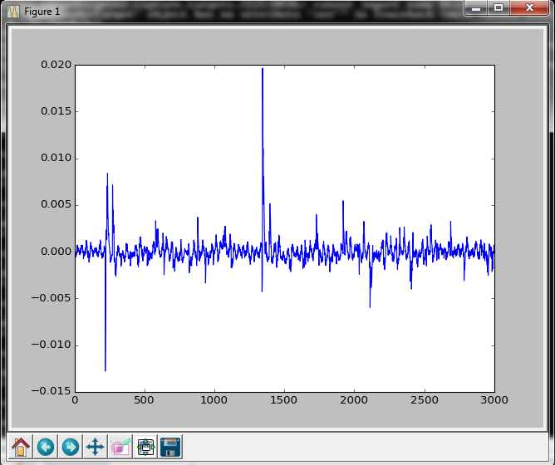
Expected Result

Slide 6
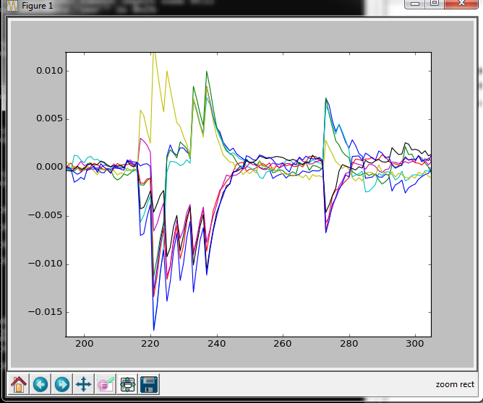
Extending to Multiple Bits
for bit in range(0, 8):
numone = 0
numzero = 0
for n in range(0, ntraces):
...

Slide 7
Making Guess from Leakage
diff = (oneguess - zeroguess).T
if diff[235] > 0:
byte |= (1<< bit)
Build up byte from this!
This training content is Copyright © NewAE Technology Inc. 2016-2017. ChipWhisperer is a trademark of NewAE Technology Inc., registered in the United States of America and Europe. See terms and conditions at ChipWhisperer.io

